Slide 1
Amex AI/ML Hackathon
Geek Goddess 2021
Bank Term Deposit Scheme
Shreya Pawaskar
shreya.pawaskar@cummincollege.in
+91 9527468625

Slide 2
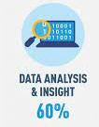

What makes the idea unique?
Machine Learning is used in banks for risk prevention and detection
The machine learning model gives accurate and precise results on the test sets as well as train sets.
ML models can help clients to improve their financial decision-making.
It will help in customer retention
The bank can make cost effective promotion campaigns
Improving Customer Experience
  Based on the results, the bank can give a better experience to a customer
Personalized Offers
  Banks can make business recommendations based on the results to the specific sets of customers

Slide 3

Problem being solved
One marketing technique in banks is phone calling the clients, getting their details and letting them know about the different schemes.
It might require multiple calls to the same client to figure out if the client will be on-board or not.
The data is related to direct marketing campaigns (phone calls) of a bank. The dataset is highly imbalanced.
Some of the attributes are :
  Age
  Job
  Martial etc.
The objective is to predict if the client will take a term deposit - variable y.

Slide 4


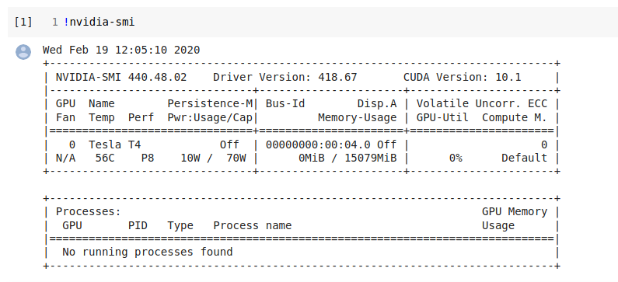
Technical architecture/ POC
The coding language used was Python
  Python offers concise and readable code.
  Python code is understandable by humans, which makes it easier to build models for machine learning.
The environment to test and train the code was Google Colab
  It is a powerful platform for learning and developing ML models in Python.
  Faster GPUs.
  More memory.
  Longer runtimes.
The hardware accelerator used in Google Colab was a GPU
  Nvidia K80 / T4
  Can continuously run for 12 hours

Slide 5




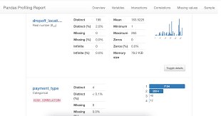
Technology/Tool Stack
Pandas
  Software library for data manipulation and analysis.
Numpy
  Library consisting of multidimensional array objects and a collection of routines for processing those arrays.
Sklearn
  Free software machine learning library for the Python
Tensorflow
  End-to-end open source platform for machine learning.
Pandas Profiling
  An open source Python module with which we can quickly do an exploratory data analysis with just a few lines of code.
  The report generated by Pandas profiling is a complete analysis without any input from the user except the dataframe object.

Slide 6
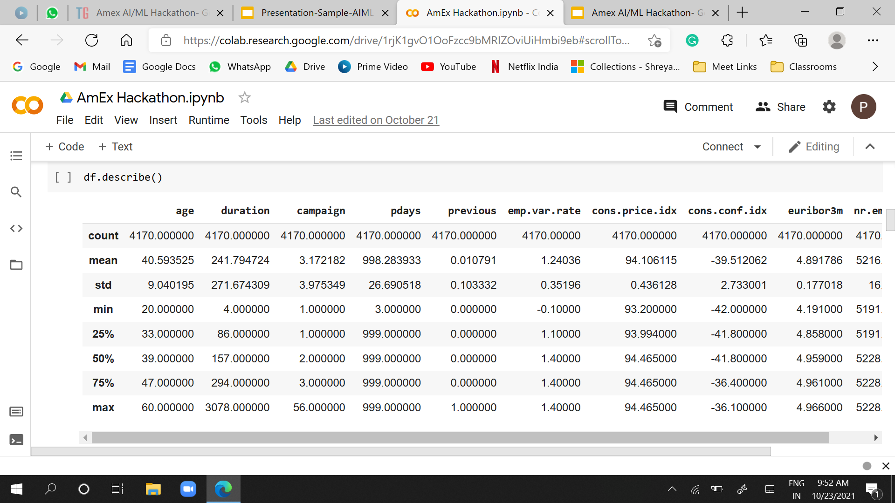
Prototype Demo(Screenshots)

Slide 7
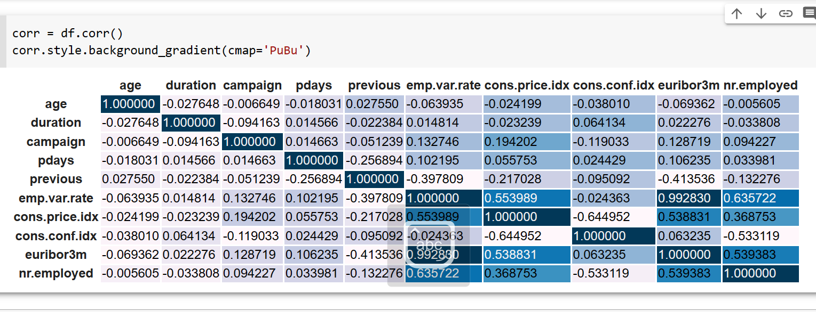
Prototype Demo(Screenshots)

Slide 8
COMPARISON WITH DIFFERENT CLASSIFIERS
GaussianNB accuracy %: 17.737296260786195
GaussianNB roc_auc_score : 0.56841046277666
GaussianNB f1_score : 0.10251046025104604
SVM accuracy % : 96.35666347075743
SVM roc_auc_score : 0.631647025007186
SVM f1_score : 0.40625
KNN accuracy % : 95.78139980824545
KNN roc_auc_score : 0.6965363610232825
KNN f1_score : 0.47619047619047616
KMEANS accuracy % : 94.24736337488015
KMEANS roc_auc_score : 0.9019114688128773
KMEANS f1_score : 0.5833333333333334
DecisionTreeClassifier accuracy %: 95.49376797
DecisionTreeClassifier roc_auc_score : 0.7435326243
DecisionTreeClassifier f1_score : 0.5154639175
MLP accuracy % : 92.90508149568552
MLP roc_auc_score : 0.9433745329117562
MLP f1_score : 0.5595238095238095

Slide 9
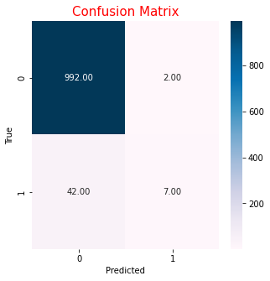
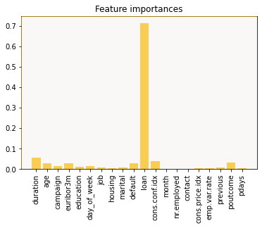
Prototype Demo Screenshots
RANDOM FOREST
accuracy % : 95.78139980824545
roc_auc_score : 0.5704225352112675
f1_score : 0.24137931034482757
accuracy (10-fold): 0.961563

Slide 10


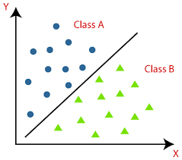
Business problem you are solving
A term deposit is a type of deposit account held at a financial institution where money is locked up for some set period of time
The business problem to be solved is which customers are more likely to respond to bank’s marketing campaigns.
This is a Machine Learning Classification Task - where we predict the yes/no based on various attributes

Slide 11
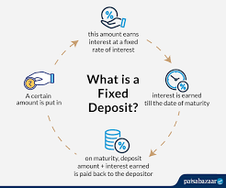
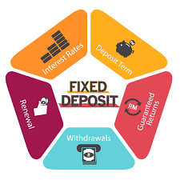
Market need to solve the business problem
Term Deposits are one of the best investment options for people who are looking for a stable and safe return on their investments.
If the banks know about that term deposits they can invest in higher gain financial products to make profits
They can also persuade these clients into buying other products such as funds, insurances, policies etc. to increase their gains.
If a customer places money in a term deposit, the bank can invest the money in other financial products that pay a higher rate of return (RoR) than what the bank is paying the customer for the use of their funds

Slide 12

Impact of usage
This information will be valuable to pay more attention to the customers who might be willing to get on-board and be in their contact.
The models can be trained on the data set and the banks can plan out a strategy which will be beneficial for them
These long term FDs will help the customers to meet their long-term financial goals
This marketing will increase the response rates of the direct promotion campaigns.
Profit growth and customer loyalty will increase
It will build good relationships among stakeholders

Slide 13
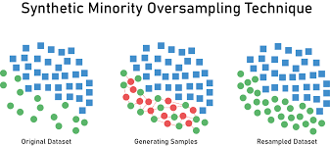
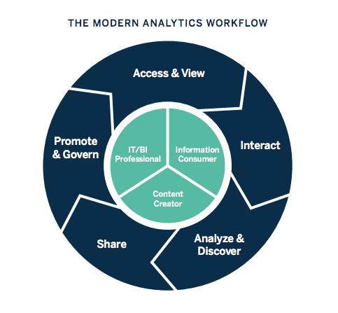
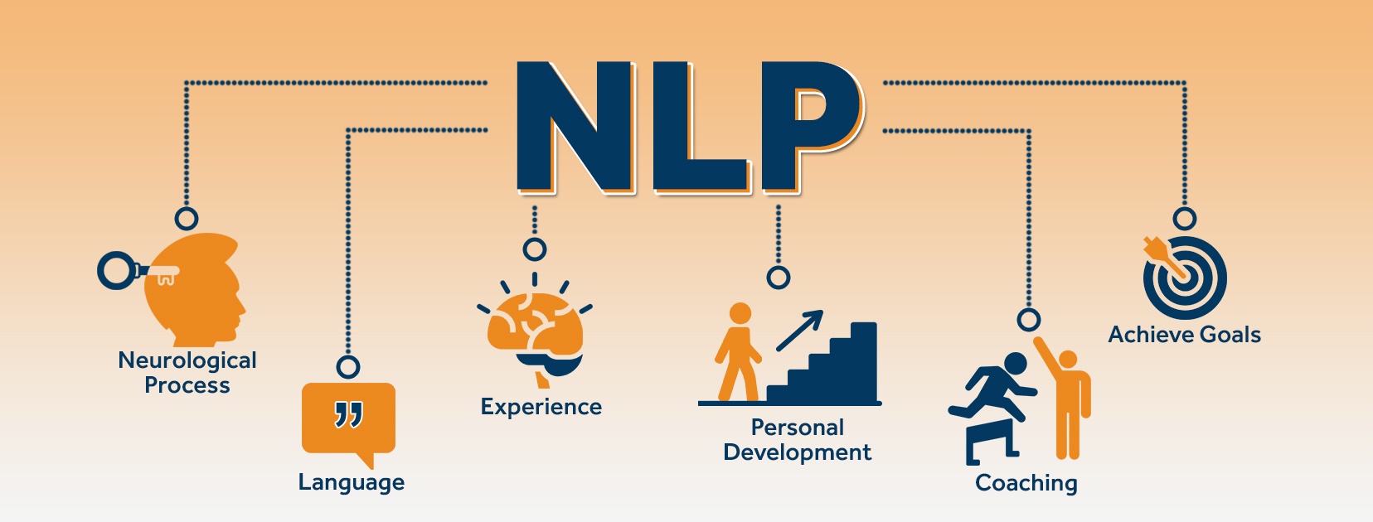
Possible Improvement
Increasing the train dataset for better results
Oversampling / Undersampling to treat imbalance data
Closer look to fill the missing values
Use of Neural Networks and Deep Learning
Use of Additional Data :
  Insights of Call Records (NLP)
  Detailed Transaction History (BI)

Slide 14
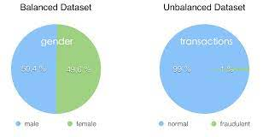
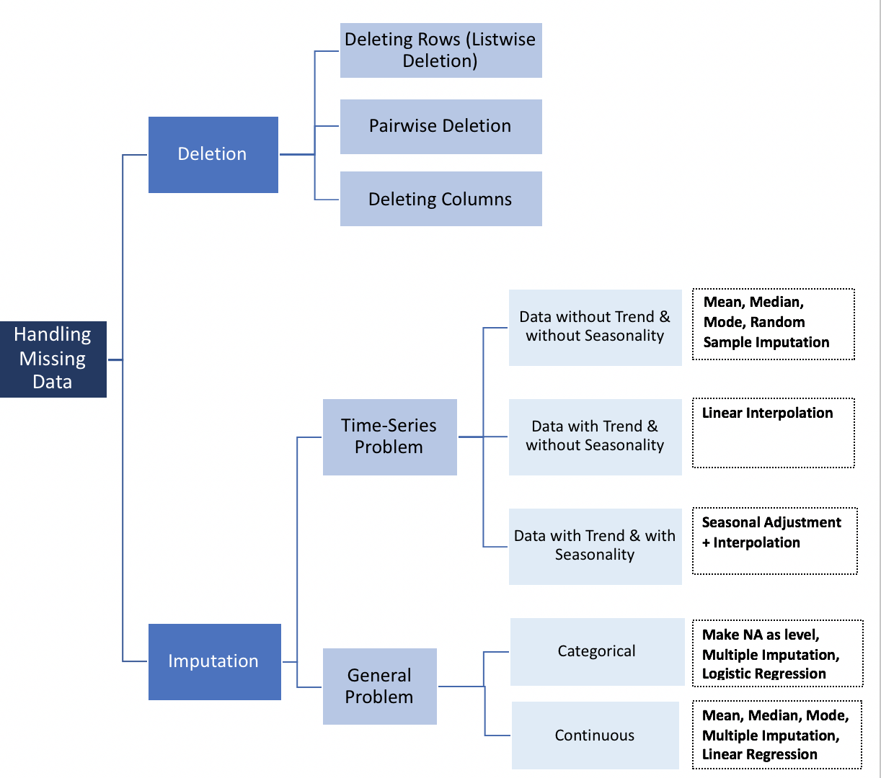
Challenges faced
Understanding financial terms and their impacts
Highly Imbalanced Dataset
Bigger Test Set and Smaller Training Set
Handling Missing Values
Mix of Categorical and Numerical Data
Dropping the unnecessary column
Choice of the correct ML Model
Hyperparameter tuning for the best Results
Feature Selection

Slide 15
REFERENCES
https://help.sap.com/saphelp_nw73/helpdata/de/99/02f1afe99c46cda61f1363755101e9/content.htm?no_cache=true
https://en.wikipedia.org/wiki/Random_forest
https://en.wikipedia.org/wiki/TensorFlow
https://towardsdatascience.com/a-mathematical-explanation-of-adaboost-4b0c20ce4382
https://medium.com/@senapati.dipak97/grid-search-vs-random-search-d34c92946318
https://github.com/pandas-profiling/pandas-profiling
https://www.knowledgehut.com/blog/data-science/bagging-and-random-forest-in-machine-learning

Slide 16
REFERENCES
ttps://www.thermofisher.com/blog/connectedlab/machine-learning-a-primer-to-laboratory-applications/
https://techvidvan.com/tutorials/svm-in-r/
https://scikit-learn.org/
https://www.tensorflow.org/
https://towardsdatascience.com/exploratory-data-analysis-with-pandas-profiling-de3aae2ddff3#:~:text=Pandas%20profiling%20is%20an%20open,a%20few%20lines%20of%20code.&text=In%20short%2C%20what%20pandas%20profiling,the%20distribution%20of%20each%20variable.
https://greatexpectations.io/blog/pandas-profiling-integration/
https://www.datacourses.com/pandas-1150/

Slide 17


